Slide 1
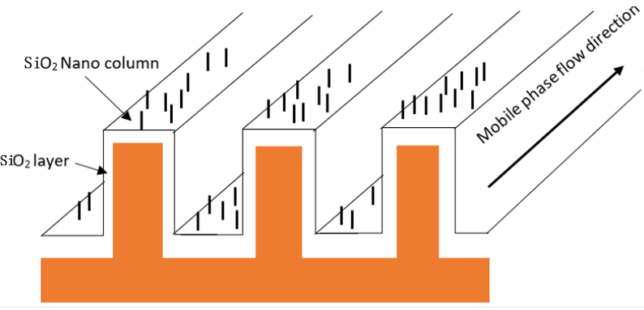
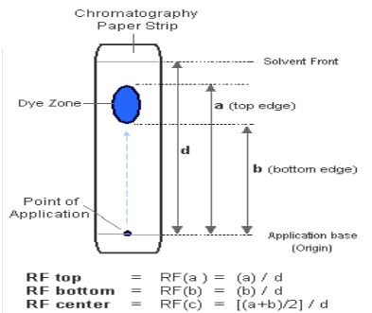
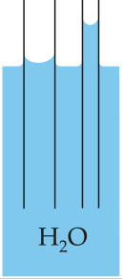
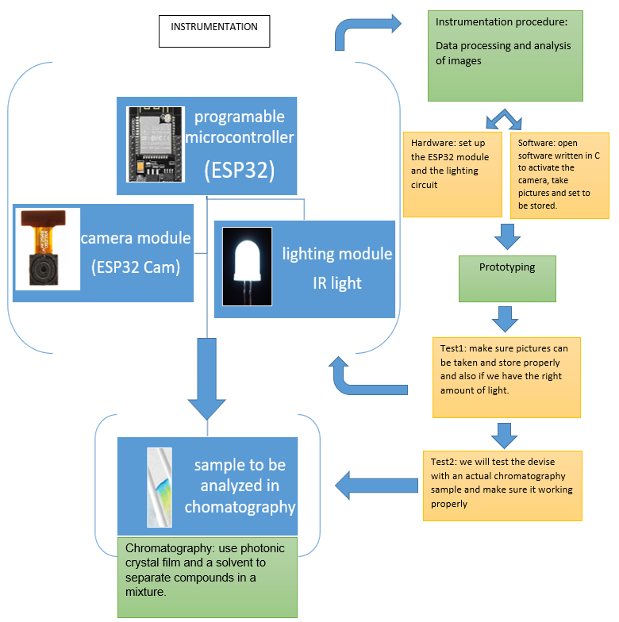
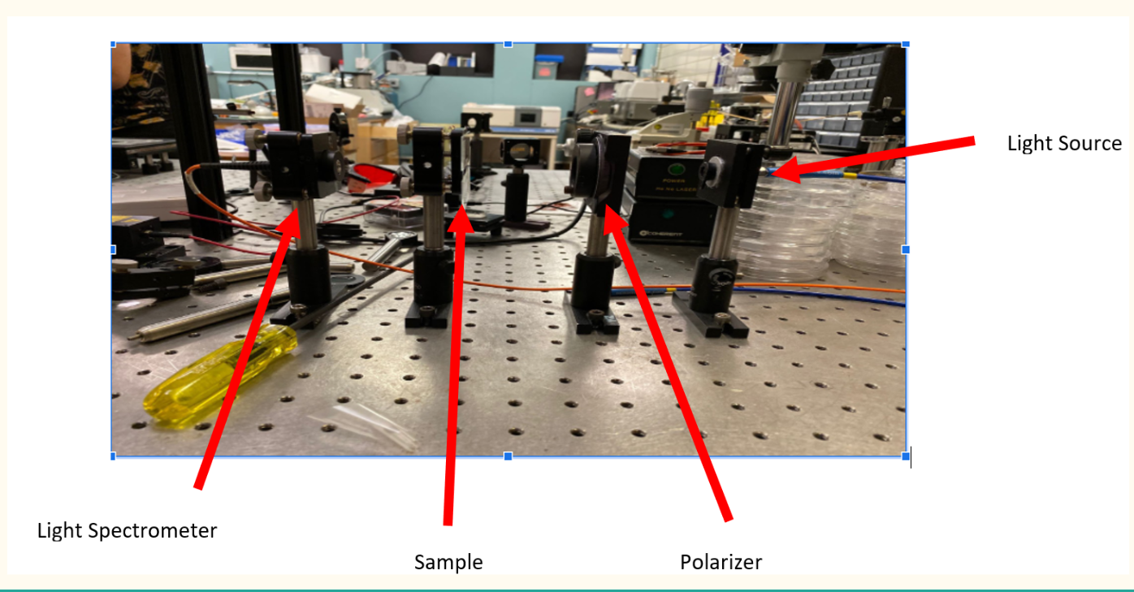
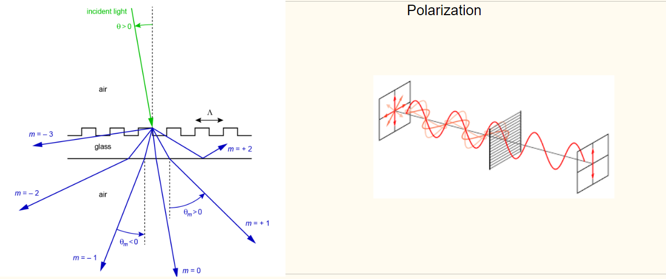
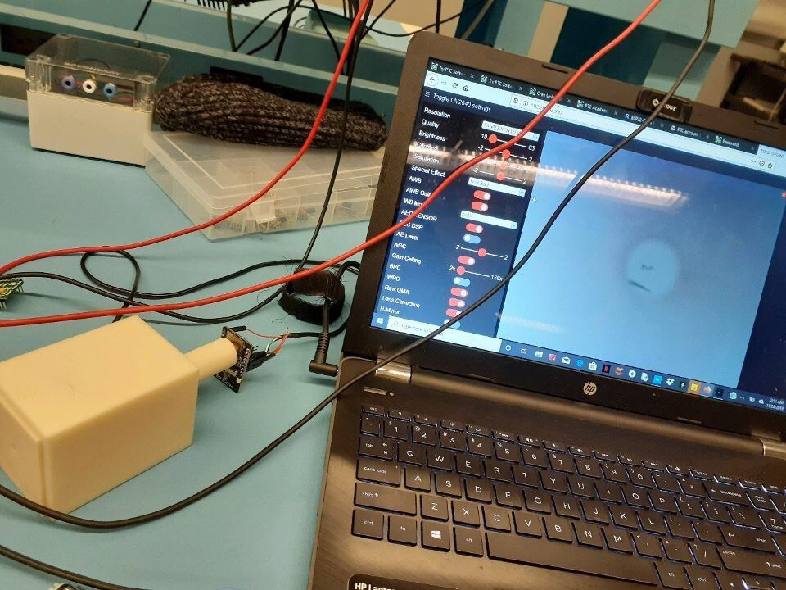
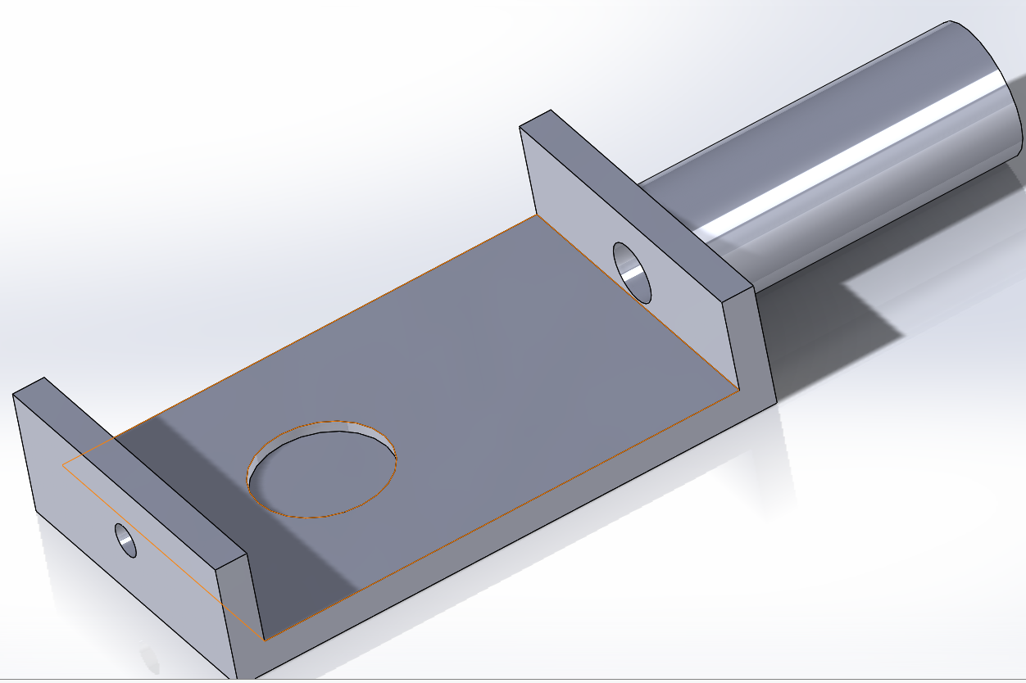
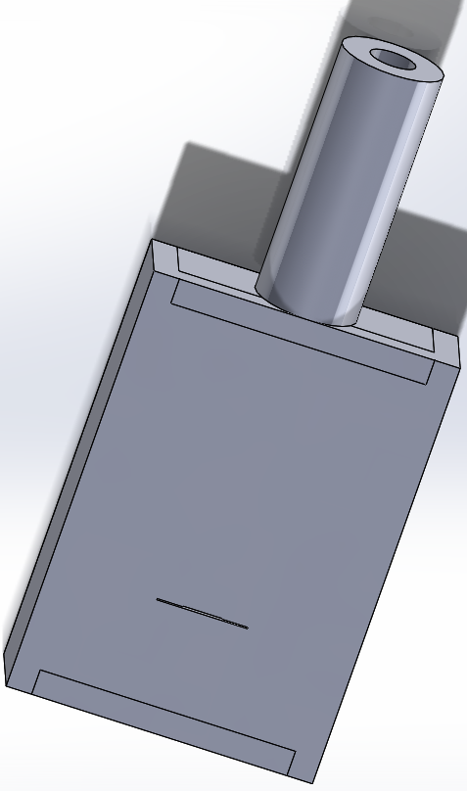
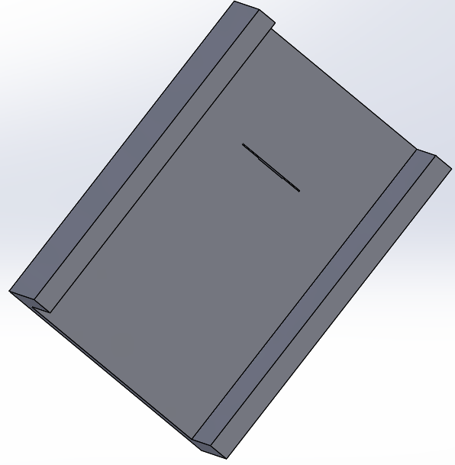
Rapid detection of Fentanyl using a multifunction nanostructured substrate
Team member: Yifu Zhang, Zheyuan Tang, Hao Wang, Ugerah Abalu, Kossi Egla, Olouwole Eteka Client : Meng Lu
Faculty Advisor: Meng Lu
Team Website: http://sddec19-07.sd.ece.iastate.edu/
Team Email: sddec1907@Iatate.edu
INTRODUCTION
The purpose of the project is to design a system that can detect fentanyl in a mixture of chemicals by separating compounds. The system uses principles of thin layer chromatography and optical instrumentation to carry out separations and detect any presence of fentanyl
Fentanyl is a potent synthetic opioid drug approved by the drug and food administration for use as a pain medication and anesthetic.
According to the USCDC, the rate of drug overdoses involving the fentanyl raised about 113% each year from 2013 to 2016 and resulted in over 10,000 overdose deaths in 2016.
Intended Users
Individuals or corporates involved in detecting and measuring fentanyl.
Law enforcement at airports and borders to detect illegal trafficking of fentanyl.
DESIGN REQUIREMENTS
GLAD deposition
Successfully deposit 10 micrometers thick layer of Silicon dioxide on a substrate which has a structure of a glancing angle columns.
RF value
Separate some unknown chemical mixtures and compare the retention values of their components to see if there is one component that has a similar RF value to what is being tested for.
DESIGN APPROACH
Capillary force
Capillary force is the ability of a liquid to flow in narrow spaces on a without the assistance of external forces like gravity
Our sensor needs to have enough capillary force to ensure liquid flow
Chromatography
Be able to separate any liquid mixture potentially containing fentanyl to prove the presence of the compound in the mixture.
Instrumentation
The main hardware being used is the ESP 32 board and camera. This camera is able to take pictures of the photonic sensor in the presence of light. Pictures taken can be automatically uploaded to the google cloud and stored for any referencing and calculations
TESTING
The images below show a visual description of the lab setup where a light source is sent through the photonic sensor which has a sample already deposited on it.
The 3D prototype being used in testing is also shown below.
PROJECT RESOURCES
1. AutoCAD 4. OceanView spectrometer software
2. Arduino IDE 5. Solidworks
3. Microsoft Excel 6. IEEE Explore for standards
RESULTS AND VALIDATION
The system is able to accurately take and store a picture of the photonic sensor inside the 3D structure during the separation process
Calculation of the concentration of compound on the photonic sensor can be done to determine what kind of compound is it.
The camera detects traces of infrared reflections from the infrared LED through the photonic sensor on the chromatography sensor.
Acknowledgement
We would like to express our special thanks of gratitude to our advisor and client Dr Meng Lu who helped us to acquire equipment and materials for this project. Also, we would like to send a special appreciation to our professor, Dr Thomas Daniel ,as well as Electronics Technology Group (ETG) who provided us with in class resources and electronics for the success of our project.

